Slide 1





Student Feedback & Teaching Improvement Analyzer
Faculty Name
Faculty Email
Dr. Namrata Chaturvedi
namratachaturvedi.mba@itmgoi.in
Mentor Name
Umamaheswari

Slide 2

Outline
Abstract of the Project
Problem Statement
Proposed Solution
System Architecture
Live Demo of the Project
Embedded Video of Project
Conclusion
Future Scope

Slide 3
Abstract
This project focuses on analyzing student feedback data using data analytics and AI tools. The data is cleaned and processed using Microsoft Excel, followed by analysis and visualization through Microsoft Power BI.
AI tools like Microsoft Copilot and ChatGPT are used to perform sentiment analysis and generate insights.
The project helps identify key trends, evaluate faculty performance, and provide actionable recommendations, enabling data-driven decision-making to improve teaching quality.

Slide 4

Problem Statement
Student feedback is collected regularly in academic institutions after each course or semester. However, this feedback often remains underutilized due to the sheer volume of responses, lack of structured analysis, and absence of a systematic process to extract actionable insights. Faculty and academic coordinators find it difficult to identify patterns, recurring concerns, or areas of teaching improvement from raw, unstructured feedback data.
Additionally, the rise of AI tools such as Microsoft Copilot and AI Chatbots presents a significant opportunity to automate feedback summarization and generate teaching improvement recommendations. However, most faculty lack the prompt engineering skills to leverage these tools effectively.
This project addresses these challenges by applying data cleaning, sentiment analysis, dashboard visualization, and AI-assisted summarization to student feedback data ,enabling faculty to understand their performance and improve teaching quality in a structured, data-driven manner.

Slide 5

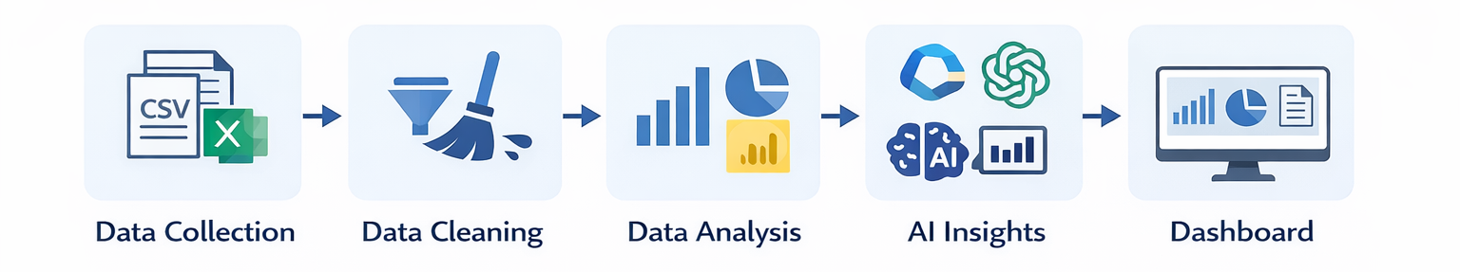
Proposed Solution
Collect student feedback data from Excel/CSV sources
Clean and preprocess data using Microsoft Excel (remove duplicates, handle missing values)
Analyze data using sentiment analysis, pivot tables, and Microsoft Power BI
Build interactive dashboards to visualize trends, faculty performance, and key insights
Integrate AI tools like Microsoft Copilot / ChatGPT for automated summaries and recommendations
Enable data-driven decision-making to improve teaching quality and student experience

Slide 6
System Architecture
Data Input / Source
Processing / Analysis
Student feedback dataset (Excel/CSV)
Faculty details and performance data
Collected from academic records or surveys
Data cleaning (remove duplicates, handle missing values) using Microsoft Excel
Data transformation and analysis using pivot tables and measures
Sentiment analysis on feedback comments
AI / Tool Integration
Output / Dashboard
Use Microsoft Copilot for automated insights
Use ChatGPT for summarization and recommendations
NLP techniques for text analysis
Interactive dashboards using Microsoft Power BI
Faculty performance insights
Feedback trends and actionable recommendations

Slide 7
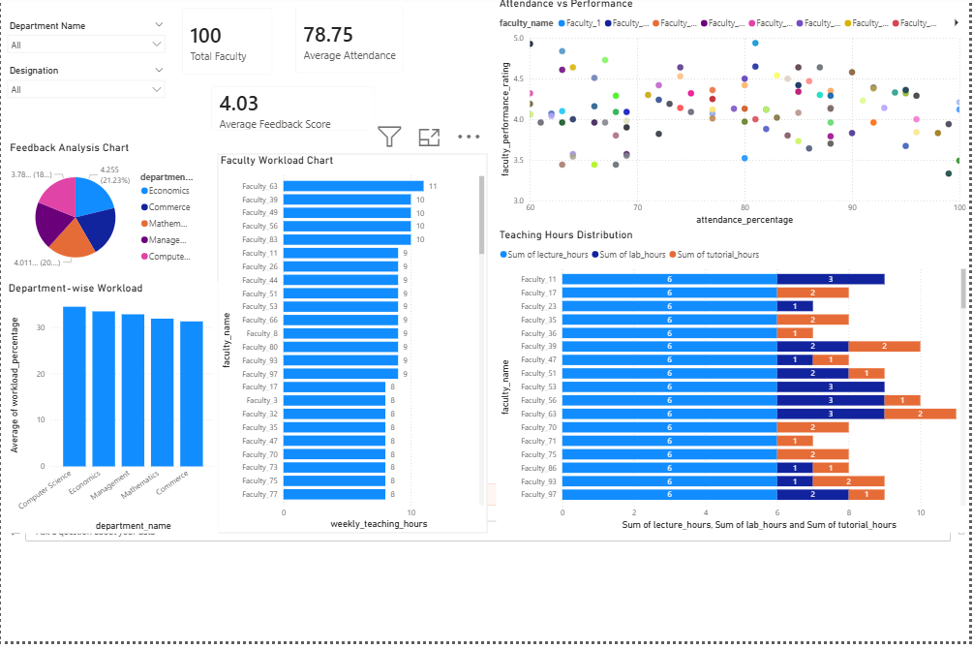

Slide 10

Conclusion
Successfully analyzed student feedback using data analytics and AI tools
Data cleaning and processing improved accuracy and reliability of insights
Interactive dashboards in Microsoft Power BI enabled clear visualization of trends and faculty performance
AI tools like Microsoft Copilot and ChatGPT enhanced analysis through automated insights and recommendations
The project supports data-driven decision-making to improve teaching quality and student experience
CONCLUSION
“Combining Data Analytics with AI leads to smarter and faster academic decision-making.”

Slide 11

Future Scope
Integrate real-time data collection using APIs or automation tools (e.g., Power Automate)
Apply advanced machine learning models for prediction and trend forecasting
Develop a web or mobile-based interface for easy access by students and faculty
Expand dataset across multiple institutions for broader analysis
Enhance AI capabilities using Microsoft Copilot and ChatGPT for smarter recommendations
Create automated alerts and performance tracking systems
Build a standardized framework for feedback analysis in education

Slide 12
Thank You
AICW Fellowship | Student Project Presentation 2026
LinkedIn | Edunet Foundation

